Slide 1

Intro to SPIDER™
(Spatial penetration and integration of distributed energy resources)
Portland, OR
Cory Welch
12.XX.2020

Slide 2
Agenda
Timing
½ hour executive summary
Optional additional ½ hour model demonstration
Introductions
Key Input and Output
Why?
Forecast Distributed Energy Resources (DERs)
SPIDER
How?
Solar PV
Battery Storage
Electric Vehicles
What?
SPIDER Demonstration
Questions

Slide 3
Introductions
Cory Welch
Principal
Office: 720.984.5184 | cwelch@nexant.com

Slide 4
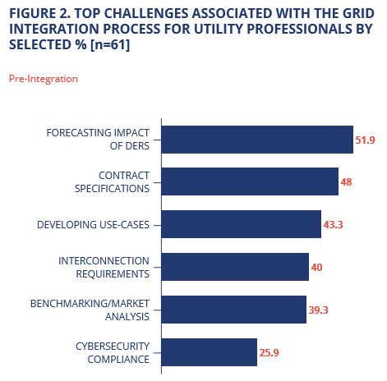
Why Forecast DERs (e.g., solar, storage, EVs)?
Rapid growth surprises planners
Poor forecasts affect profits and reliability
High penetration affects rate design
Increased interest in integrated distribution planning
Many states require it:
California: 2017
Nevada: 2018
Minnesota: 2018
Colorado: 2019
2021 and beyond?
Other?
https://sepapower.org/resource/2019-grid-integration-insights
Notes:
Will make efforts to tailor our discussion & address key issues to the extent we are able.

Slide 5
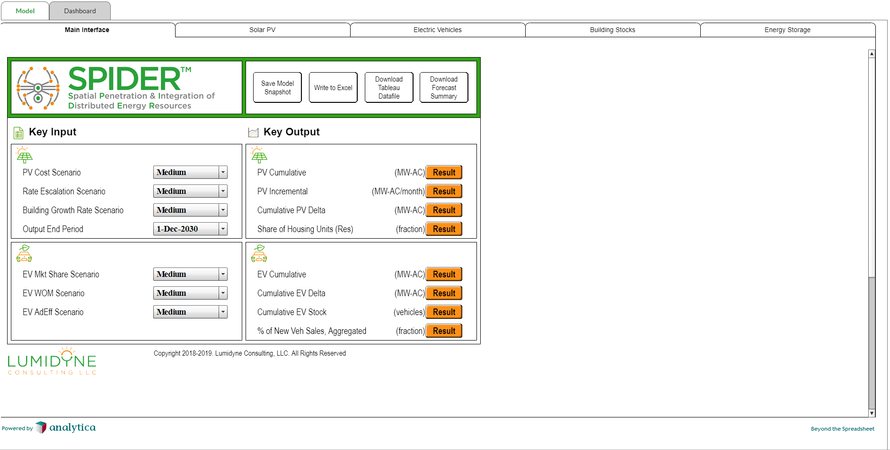
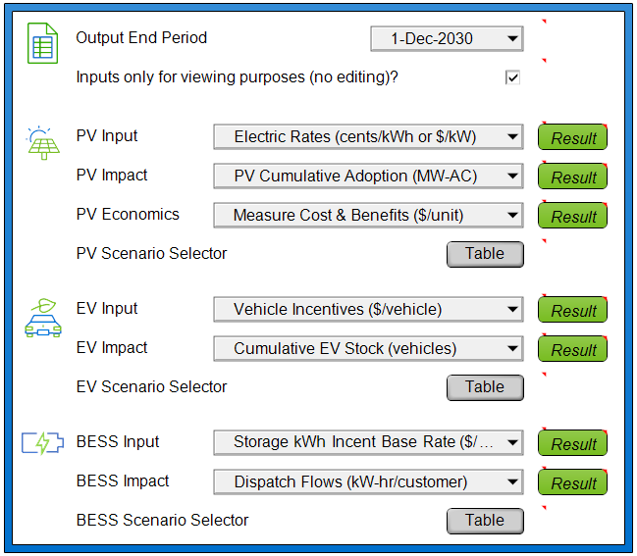
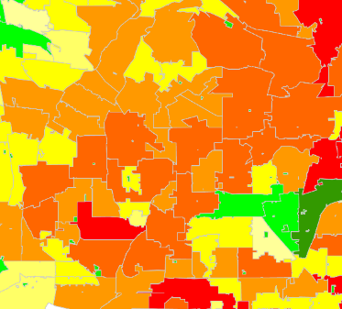
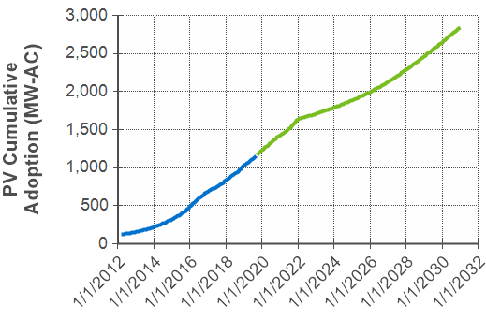
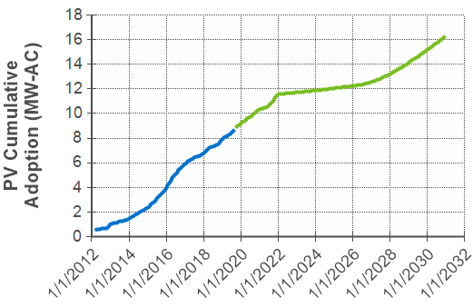
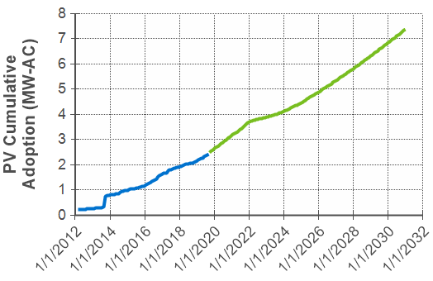
Why SPIDER?
Accuracy
Flexibility & Transparency
Scenario Analysis Capability

Slide 6
Key Input and Output
Key Input
Key Output
Technology costs
Performance characteristics
Historical adoption
Load and generation shapes
Electric rates
Tax credits and incentives
Fuel prices
System level or spatial adoption forecast
ZIP Codes, or feeders
Number of units, installed MW, etc.
Hourly energy and peak demand impacts (hourly)
Optimal storage dispatch

Slide 7
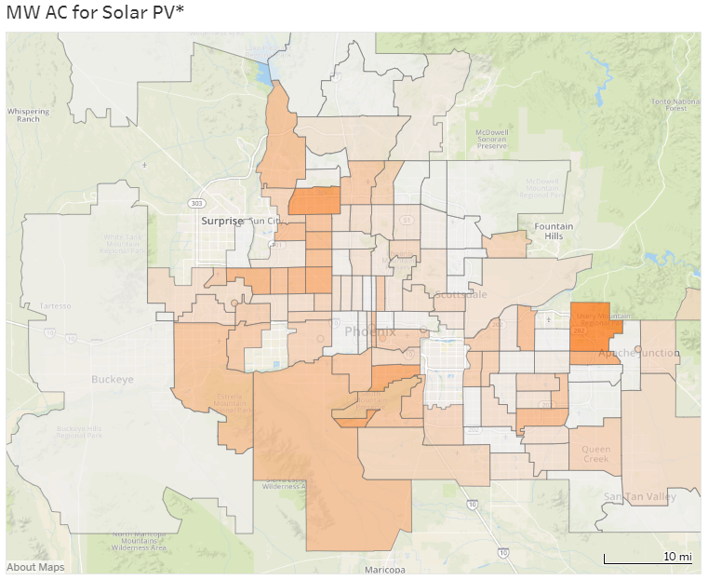
Accuracy
Calibrated to spatial adoption patterns
Out-performs “propensity” allocation
Rigorous economics
Discounted cash flow analysis of all system types
All components of bill savings & avoided costs
Import or create any electric rate
Storage dispatch optimization module
R²=0.92

Slide 8
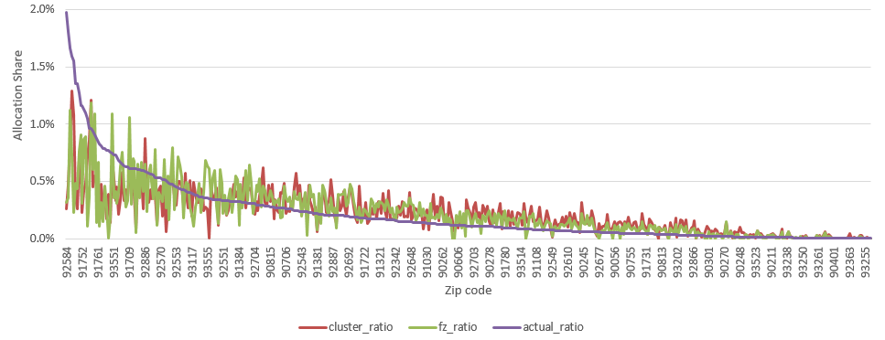
Accuracy: Forecast vs. Actuals, Residential PV
Lower Errors + No Systematic Bias,
R² = 0.92
(SPIDER)
Spatial Time-Series Calibration Approach
% of MW Impact
Higher Errors + Systematic Bias
R² = ??
Other Firm’s Allocation Approach
(e.g., machine learning, propensity, etc.)
% of MW Impact
Forecast method 1 ----
Forecast method 2 ----
Actuals ----

Slide 9
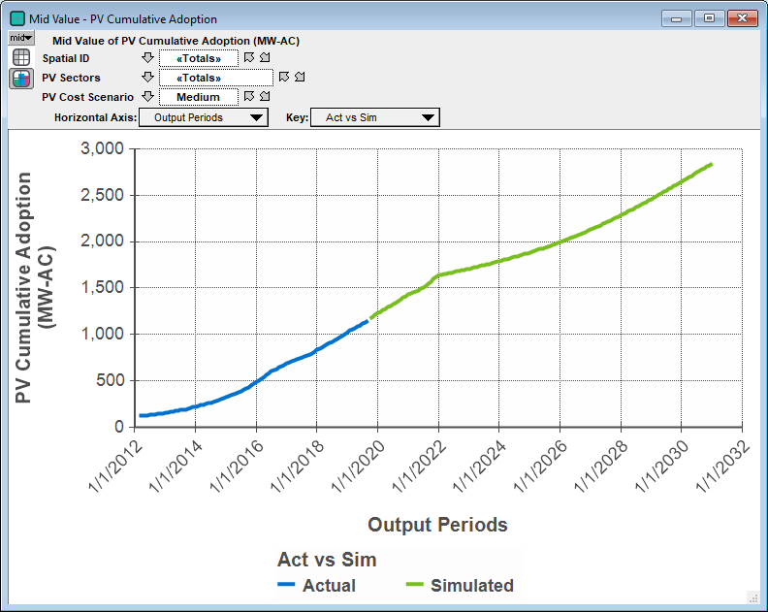
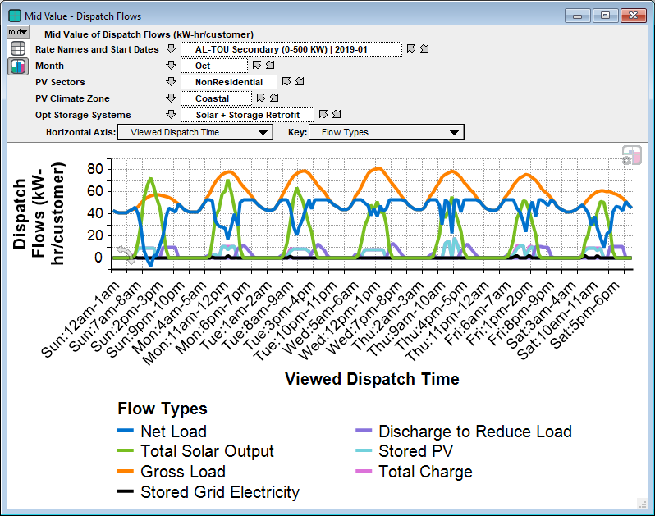
Flexible & Transparent
Rapid customization ability makes it easy to say “yes.”
Transparent user interface
Ready access to all model input assumptions and outputs

Slide 10
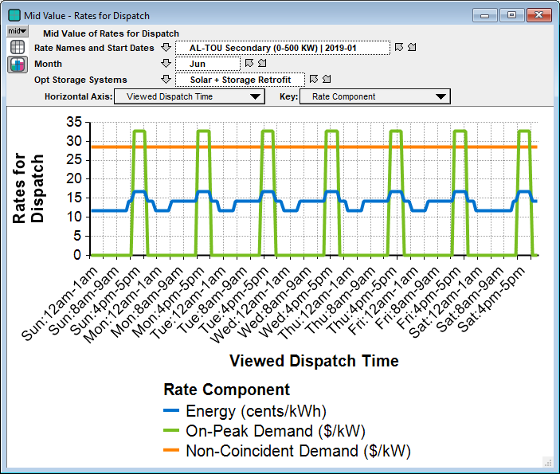
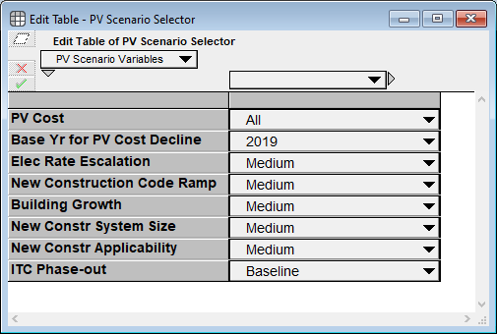
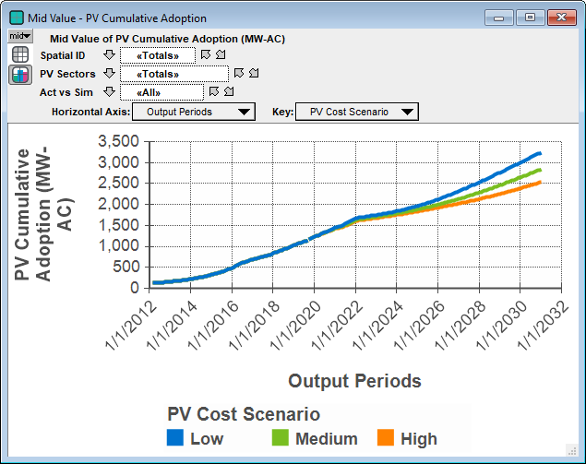
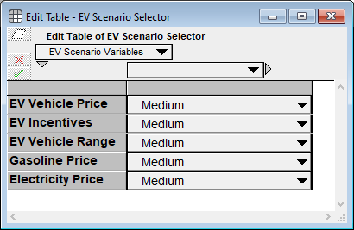
Extensive Scenario Analysis Ability
Rapid scenario analysis on any input
incentives, rates, costs, tax credits, etc.
Runs in seconds once calibrated
Ability to test any rate design (TOU, demand charges, etc.)

Slide 11
How? Adoption approach
Bass diffusion and System Dynamics capture complex DER market dynamics for any future scenario. Enables time-varying factors (e.g., costs)
Stock & Flow Diagram
Typical Adoption Pattern

Slide 12

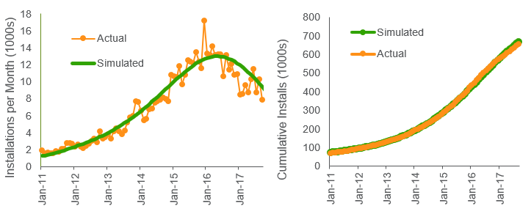
How? Calibration
Calibration
Spatial Impacts
Source: Lumidyne

Slide 13
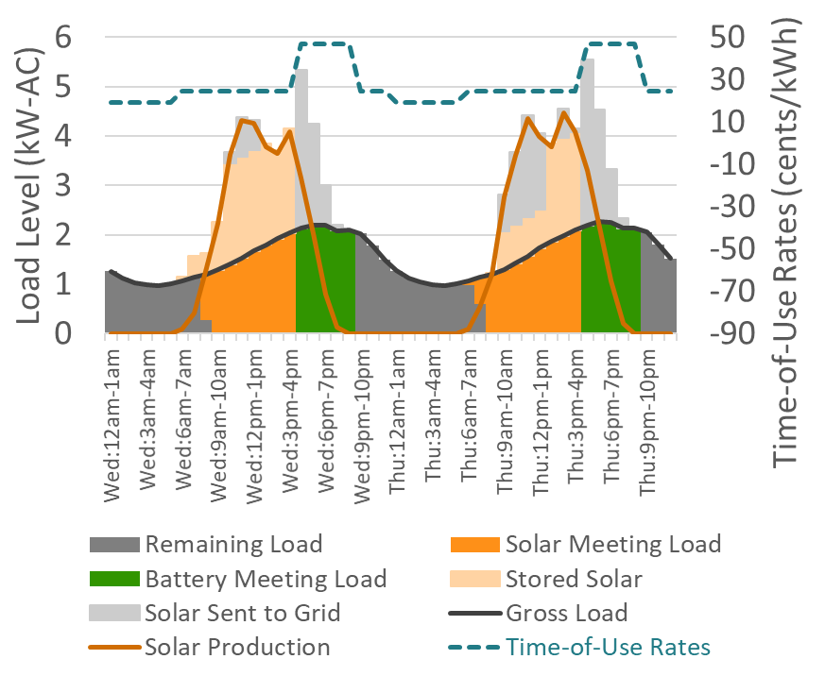
How? Storage
Dispatch: optimized for any rate structure
Adoption: Bass diffusion
Systems: Multiple
Storage only
Storage + solar
Value Stacking: Flexible
Ancillary services
Demand response
Etc.
Hourly Dispatch

Slide 14
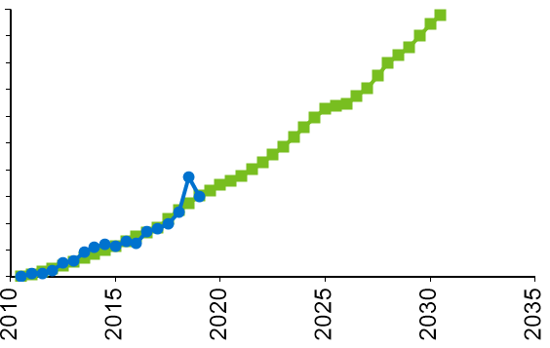
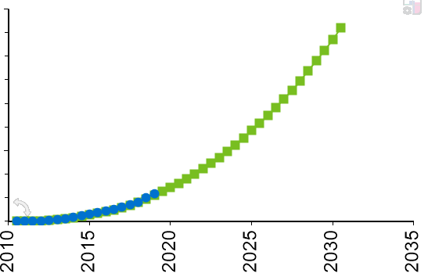
How? Electric Vehicles
Multi-attribute customer decision algorithm combined with Bass diffusion and stock/flow model
Calibration
Stock & Flow Diagram
Simulated
Actual
EVs/year
Total EVs

Slide 15
What? Demonstration

Slide 16
Questions

